Slide 1


Slide 2
AIR QUALITY PREDICTION
Supervised By:
Dr. Himanshu Sharma (Asst. Professor Department of Computer Engineering & Applications)
TEAM
SAKSHI SRIVASTAVA (171500285)
AYUSHMAN AWASTHI (171500081)

Slide 3
Why Air Quality Prediction ???
Humans are very sensitive to humidity, as the skin relies on the air to get rid of moisture. The process of sweating is your body's attempt to keep cool and maintain its current temperature.
If the air is at 100-percent relative humidity, sweat will not evaporate into the air. As a result, we feel much hotter than the actual temperature when the relative humidity is high. If the relative humidity is low, we can feel much cooler than the actual temperature because our sweat evaporates easily, cooling us off.

Slide 4
For Example
If the air temperature e is 75 degrees Fahrenheit (24 degrees Celsius) and the relative humidity is zero percent, the air temperature feels like 69 degrees Fahrenheit (21 C) to our bodies. If the air temperature is 75 degrees Fahrenheit (24 C) and the relative humidity is 100 percent, we feel like it's 80 degrees (27 C) out.

Slide 5
OBJECTIVE
Accurate forecasting helps people plan ahead, decreasing the effects on health and the costs associated. If people are aware of variations in the quality of the air they breathe, the effect of pollutants on health as well as concentrations likely to cause adverse effects and actions to curtail pollution.
So we will predict the Relative Humidity of a given point of time based on the all other attributes affecting the change in RH.

Slide 6
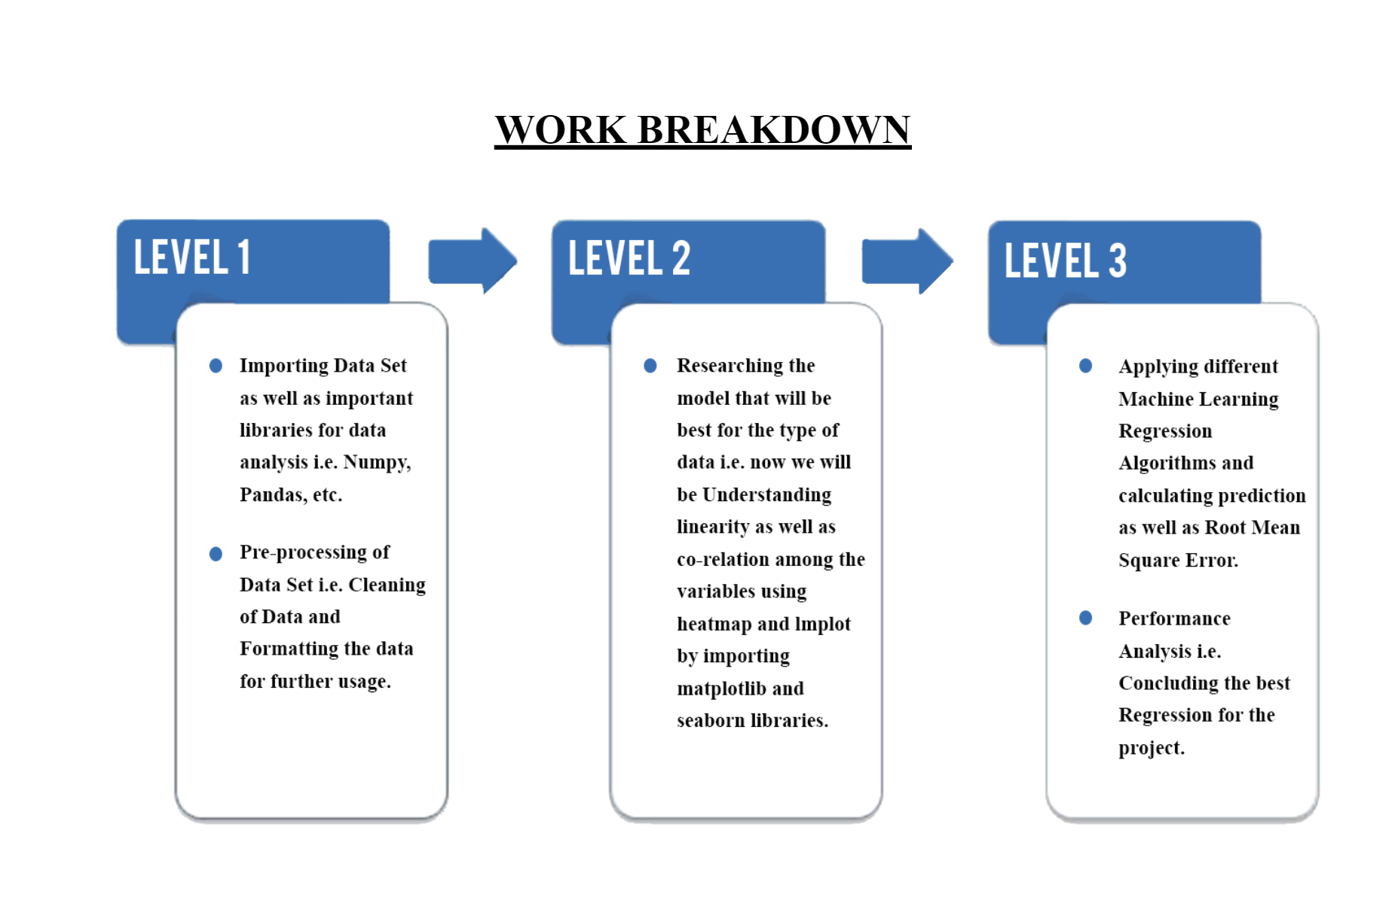
Working of Air Quality Prediction

Slide 7
BREAKDOWN
The Complete project has been completed in three levels. • In the first level of this project we will import the Air Quality Index data set which we have downloaded from Kaggle. We will also import some useful libraries to read, clean and format the data set according to our need so we can use it further.
In the second level of this project we will be understanding the relationship between the variables of the data set i.e. linearity and co-relation to predict out that which model will be best for us in our analysis.
In the third i.e. the last level of our project we will apply different Machine Learning Regression algorithms after importing the suitable libraries. At the end of every model we will calculate the Root Mean Square Error. This will help us in the performance analysis to make a conclusion that which regression model was best suited for our project

Slide 8
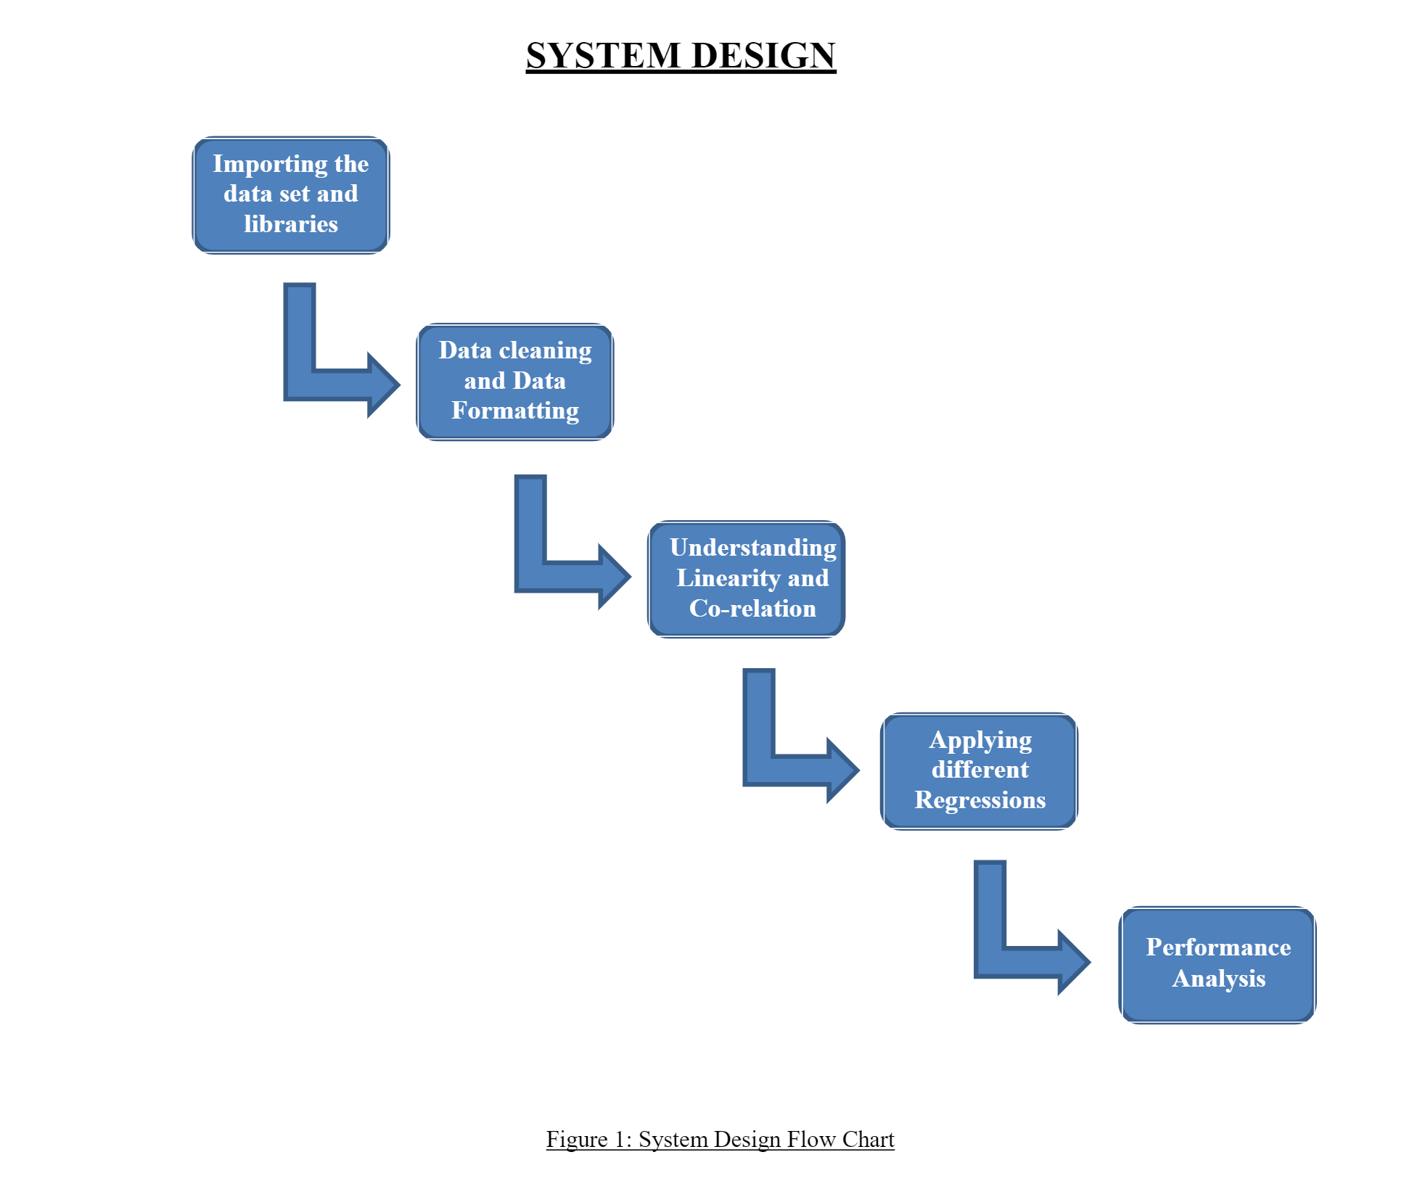
System Design

Slide 9
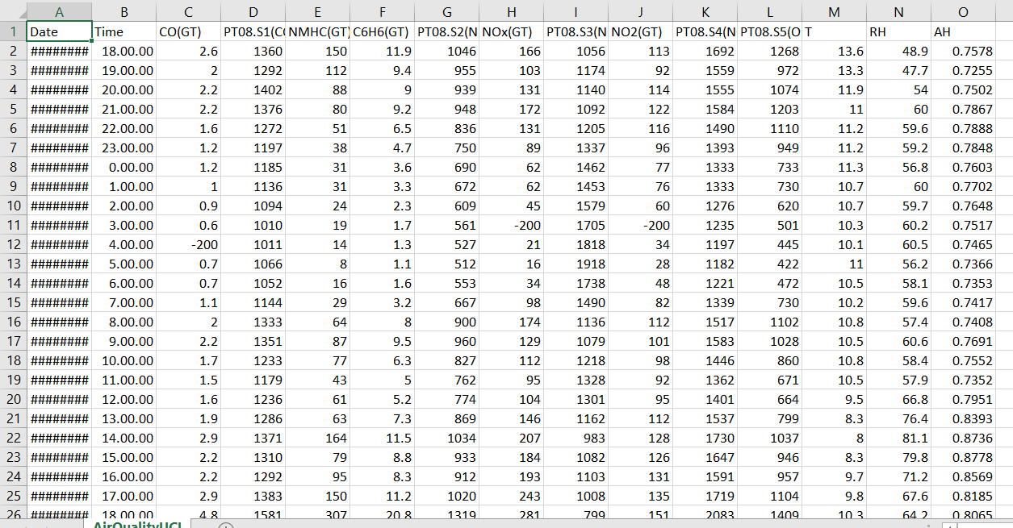
DATASET

Slide 10
DATASET
The dataset contains 9358 instances of hourly averaged responses from an array of 5 metal oxide chemical sensors embedded in an Air Quality Chemical Multisensor Device. The device was located on the field in a significantly polluted area, at road level, within an Italian city. Data were recorded from March 2004 to February 2005 (one year) representing the longest freely available recordings of on field deployed air quality chemical sensor devices responses. Ground Truth hourly averaged concentrations for CO, Non Metanic Hydrocarbons, Benzene, Total Nitrogen Oxides (NOx) and Nitrogen Dioxide (NO2) and were provided by a co-located reference certified analyzer.

Slide 11
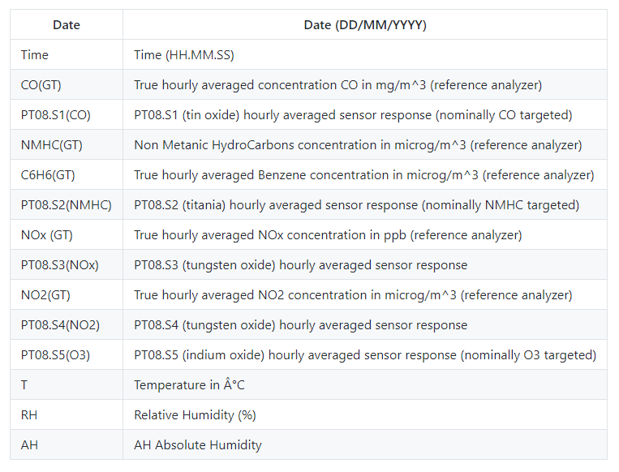
Features

Slide 12
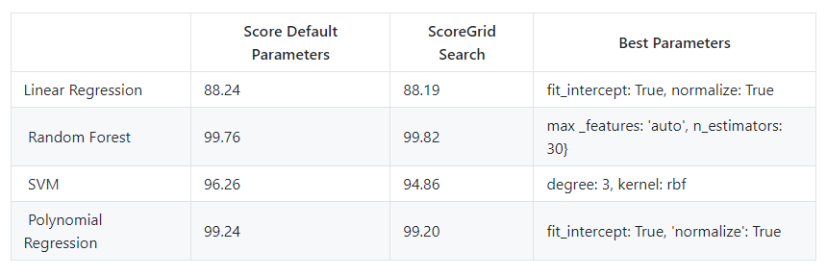
Model and hyper-parameters comparison

Slide 13
Conclusions
Random Forests and Polynomial Regression did a great job predicting relative humidity.
Since the default parameters already did a great job, there was no room left for improvement of the models with the help of grid search.
Based on the correlation between the variables and the target, removal of less correlated variables did not improve the accuracy of the prediction, therefore, all the variables were used in the prediction.
In addition, for Linear and Polynomial regressions not many parameters can be changed, therefore, grid search contribution to the improvement of the model score was very low.

Slide 14
THANK YOU

